Slide 1
Final Revision

Slide 2
Final Exam

Slide 3


Slide 4
Final Exam
  Time: 3 hour (Open Book – but only paper materials; No computing device, similar to midterm) Six questions
Include everything but emphasize more on topics after midterm
  FDs & Normalization, Indexing techniques, Optimization, Transaction Management, Oracle PL/SQL
On conceptual understanding rather than memorizing facts
On mastering database issues rather than memorizing facts
On problem solving rather than memorizing facts
Advice: Revise your slides, Lab work and Exercises
Important Moment: 18 May 2015 (Mon), 12:30-15:30, HALL

Slide 5
Focuses more on…
FD & Normalizations
Index Structures
Sorting and Hashing
RA Implementation
  Sorting, Selection, Join,…
Query Optimization
Transaction Management

Slide 6
Functional Dependencies
The functional dependency X → Y holds on R if and only if for any legal relations r(R), whenever any two tuples t₁ and t₂ of r agree on the attributes X, they also agree on the attributes Y.
The set of all functional dependencies logically implied by F is the closure of F.
For computing the closure we use Armstrong’s axioms
  if Y ⊆ X, then X → Y (reflexivity)
  if X → Y, then ZX → ZY (augmentation)
  if X → Y, and Y → Z, then X → Z (transitivity)
Given a set of attributes X, the closure of X under F (denoted by X ⁺) is the set of attributes that are functionally determined by X under F
If X determines all attributes, then it is a superkey. If it is also minimal, then it is a candidate key.
A canonical cover of F is a “minimal” set of functional dependencies equivalent to F, without any redundant dependencies or redundant attributes.

Slide 7
Database Design
Goal
  remove redundancy & preserve constraints
Major normal forms
  BCNF: for every non-trivial FD without useless attributes X  → Y, X is a candidate key.
  3NF: a table in BCNF also satisfies 3NF. In addition, 3NF allows FDs where every attribute in Y is prime.
  2NF: a table in 3NF also satisfies 2NF. In addition, 2NF allows FDs where X is not a proper subset of a candidate key.
  1NF: every relational table is 1NF because all attribute values are atomic.

Slide 8
BCNF Decomposition Algorithm
Compute F⁺;
Result = {R};
While (any X→Y in F⁺ on a schema R_{i} in Result violates BCNF) {
Create a new table (X,Y);
Result = (Result-{R_{i}}) U {(R_{i} - Y)} U {(X,Y)};
}
The final tables are in BCNF. The decomposition is lossless-join, does not have redundancy, but may not preserve dependencies.

Slide 9
3NF Decomposition Algorithm
Let F_{c} be a canonical cover for F
for each X → Y in canonical cover F_{c}
create (X,Y)
if none of the created tables contains a candidate key
create a table with any candidate key for R;
The final tables are in 3NF. The decomposition is both lossless-join and dependency-preserving, but the tables may have redundancy.

Slide 10
Basic Concepts of Indexing
Search Key - attribute to set of attributes used to look up records in a file
An index file consists of records (called index entries) of the form
Index files are typically much smaller than the original file
Important database indices:
  Ordered indices: search keys are stored in sorted order
  Hash indices: search keys are distributed uniformly across “buckets” using a “hash function”
  B+ tree indices: self-maintainable and efficient index scheme
search-key
pointer

Slide 11
Ordered Indices
In an ordered index, index entries are stored sorted on the search key value. E.g., author catalog in library
Primary index: in a sequentially ordered file, the index whose search key specifies the sequential order of the file
  Also called clustering index
  The search key of a primary index is usually but not necessarily the primary key
Secondary index: an index whose search key specifies an order different from the sequential order of the file. Also called
non-clustering index
Index-sequential file: ordered sequential file with a primary index (also called ISAM - indexed sequential access method)

Slide 12
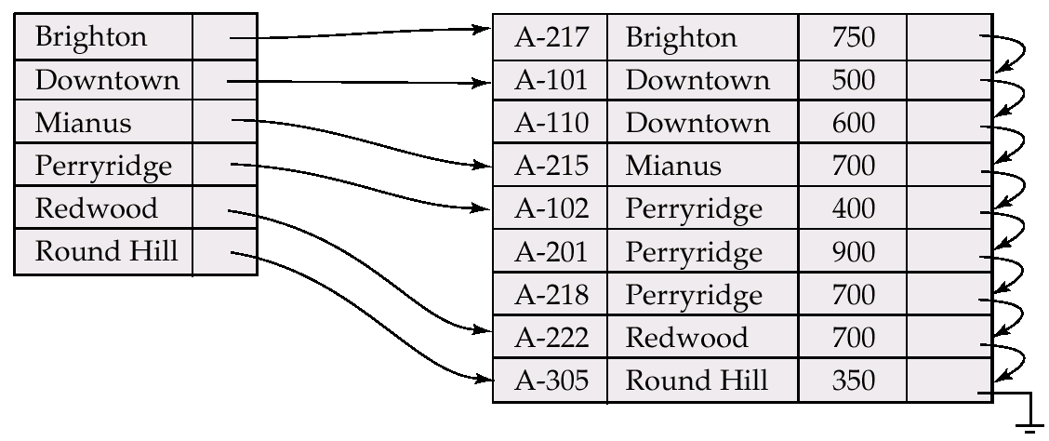
Dense Index Files
Dense index — Index record appears for every search-key value in the file (in this example we have clustering index)
Index
Data Records

Slide 13
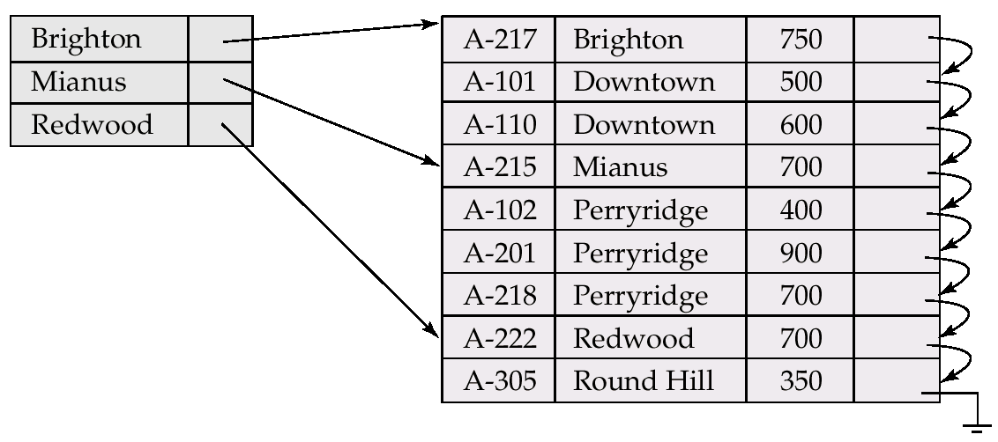
Sparse Index Files
Sparse Index - contains index records for only some search-key values
  Applicable when records are sequentially ordered on search-key (i.e., only applicable to clustering indexes)
Index
Data Records

Slide 14
Secondary (Non Clustering) Indices on Non-Key Attributes
Frequently, one wants to find all the records whose values in a certain field (which is not the search-key of the primary index) satisfy some condition.
  Example 1: In the account database stored sequentially by account number, we may want to find all accounts in a particular branch
  Example 2: as above, but where we want to find all accounts with a specified balance or range of balances
We can have a secondary index with an index record for each search-key value; index record points to a bucket that contains pointers to all the actual records with that particular search-key value

Slide 15
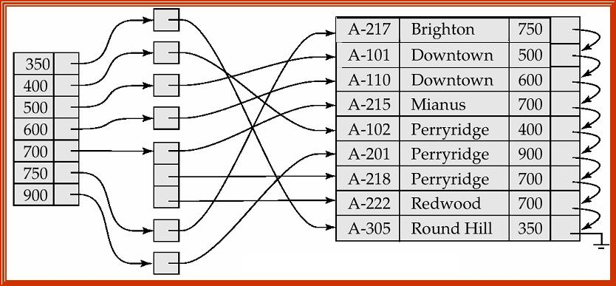
Secondary Index on balance field of account
Secondary
Index

Slide 16
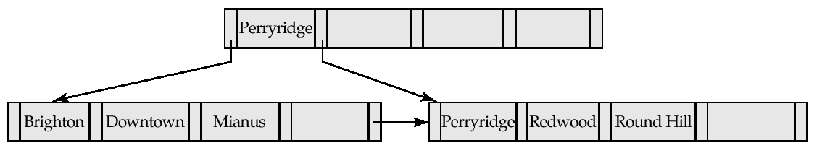
B⁺-tree
A B⁺-tree built for account file with n = 5
  Leaf nodes must have between 2 and 4 data values
    I.e. ⎡(n–1)/2⎤ and n –1, with n = 5
  Non-leaf nodes other than root must have between 3 and 5 children
    I.e. ⎡(n/2)⎤ and n, with n =5
  Root must have at least 2 children

Slide 17
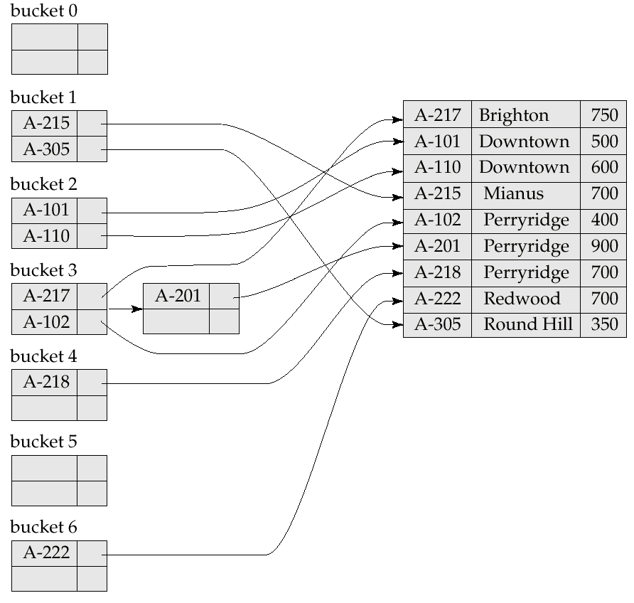
Hash Indices
Hashing can be used not only for file organization, but also for index-structure creation
A hash index organizes the search keys, with their associated record pointers, into a hash file structure
Hash indices are always secondary indices

Slide 18
Extendible Hashing
Situation: Bucket (primary page) becomes full. Why not re-organize file by doubling # of buckets?
  Reading and writing all pages are expensive!
  Use directory of pointers to buckets, double the number of buckets by doubling the directory, splitting just the overflowed bucket!
  Directory is much smaller than file, so doubling it is much cheaper. Only one page of data entries is split. No overflow page!
  Important: how hash function is adjusted!
Notes:
5

Slide 19
Example
LOCAL DEPTH
2
4*
12*
32*
16*
Bucket A
GLOBAL DEPTH
Directory is an array of size 4 (2 bits)
To find bucket for the search key r, take last `global depth’ # bits of h(r); we denote r by h(r)* in buckets.
  If h(r) = 5 = 101(binary), it is in the bucket pointed by 01 (i.e. 5* in Bucket B)
  Why is 13* also in B?
Note: Buckets A and B are full
2
2
00
1*
5*
21*
13*
Bucket B
01
10
2
10*
Bucket C
11
DIRECTORY
2
15*
7*
19*
Bucket D
DATA PAGES
Insert: If bucket is full, split it (allocate new page, re-distribute)
If necessary, double the directory. (Splitting a bucket does not
always require doubling – decision by comparing global depth
with local depth)
Notes:
6

Slide 20
External Sort-Merge
Let M denote memory size (in pages)
Create sorted runs. Let i be 0 initially
Repeatedly do the following till the end of the relation R:
(a) Read M pages of R into memory
(b) Sort the in-memory M pages
(c) Write sorted data to run R_{i}; increment i
Let the final value of i be N. I.e. Sorted Runs = {R₀ ,…,R_{N-1}}
Merge the runs (N-way merge). We assume (for now) that N < M
  Use N pages of memory to buffer input runs, and 1 page to buffer output
  Read the first page of each run into its buffer page
  repeat
    Select the first record (in sort order) among all buffer pages
    Write the record to the output buffer. If the output buffer is full write it to disk
    Delete the record from its input buffer page
    If the buffer page becomes empty then
    read the next page (if any) of the run into the buffer
  until all input buffer pages are empty

Slide 21
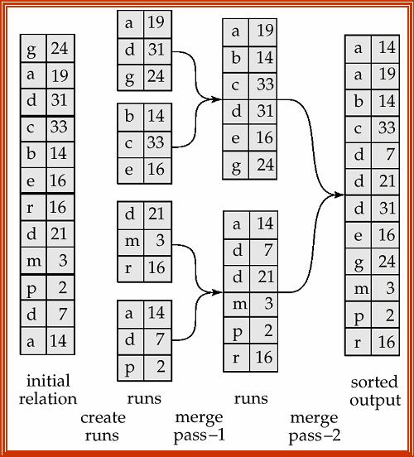
Example of External Sort-Merge
assuming 1 record per page and 3 buffer pages

Slide 22
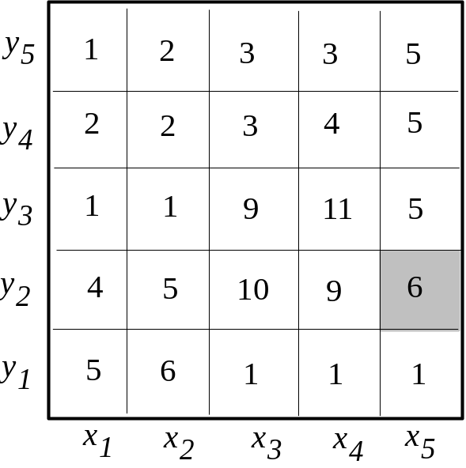
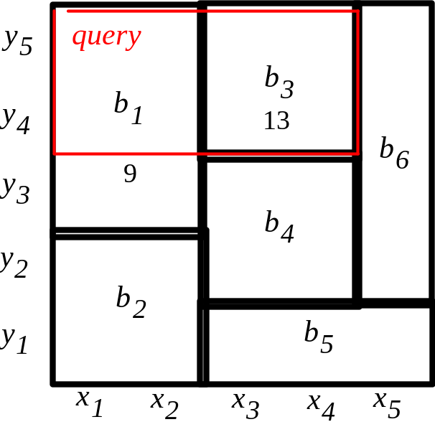
Multi-dimensional Histograms
Main idea:
  Divide the space (e.g., age-rating) in buckets, so that data in each bucket are almost uniform
  Keep in memory the bucket extents and the number of records per bucket
  Use this information to estimate the number of objects in query window. Example: “where y₄≤y ≤ y₅ and x₁ ≤ x ≤ x₄”
Size est for the query
=b₁x4/6 +b₃
=6+13 =19

Slide 23
Join Processing
Several different algorithms to implement joins
Cost estimate only take into account the I/O operations (reads and writes of pages)
Notation:
  r s – two relations to be joined
  n_{r} n_{s} - number of records in r, s
  b_{r} b_{s} - number of pages in r, s
  M - available memory in pages
Assume equijoins on the following tables
  Customer: n_{customer} = 10,000 records, b_{customer} = 400 pages
  Depositor: n_{depositor} = 5,000 records, b_{depositor} = 100 pages
The join attribute is the customer-name, which is the key of Customer

Slide 24
Block Nested-Loop Join
We wish to compute r s
r is called the outer relation and s the inner relation of the join
Block nested loop join requires no indices and can be used with any kind of join condition
for each block B_{r} of r do begin
for each block B_{s} of s do begin
for each tuple t_{r} in B_{r} do begin
for each tuple t_{s} in B_{s} do begin
if (t_{r},t_{s}) satisfies the join condition
add (t_{r},t_{s}) to the result

Slide 25
Block Nested-Loop Join (Cont.)
Worst case estimate: b_{r} ∗ b_{s} + b_{r} page accesses.
  Each page in the inner relation s is read once for each page in the outer relation
Best case: b_{r} + b_{s} block accesses (Why?)
Improvements to nested loop and block nested loop algorithms:
  In block nested-loop, use M-2 disk pages as blocking unit for outer relation r, where M = memory size in pages; use remaining two pages to buffer inner relation s and output
  Cost = ⎡b_{r} / (M-2)⎤ ∗ b_{s} + b_{r}
Further Optimizations:
  If equi-join attribute forms a key on inner relation s, stop inner loop on first match
  Scan inner loop forward and backward alternately, to make use of the previously scan pages remaining in buffer
  Use an index on the inner loop’s equi-join attribute

Slide 26
Example of Block Nested-Loop Costs
Compute depositor JOIN customer, with depositor as the outer relation
  Number of pages of b_{depositor}= 100, b_{customer}=400
Worst case cost of block nested-loop
  100*400 + 100 = 40,100 page accesses
  How many main memory pages you need to apply block nested-loop?
Best case cost of block nested-loop join
  100 + 400 = 500 page accesses
  How many main memory pages you need to achieve this cost?
Cost of block nested loops join with 52 main memory pages
  2*400 + 100 = 900 page accesses

Slide 27
Indexed Nested-Loop Join
Index lookups can replace file scans if
  join is an equi-join or natural join and
  an index is available on the inner relation’s join attribute
  Can construct an index just to compute a join
For each tuple t_{r} in the outer relation r, use the index to look up tuples in s that satisfy the join condition with tuple t_{r}
Cost of the join: b_{r} + n_{r} ∗ c
  Where c is the cost of traversing index and fetching all matching s tuples for one tuple or r
  c can be estimated as cost of a single selection on s using the join condition
If indices are available on join attributes of both r and s, use the relation with fewer tuples as the outer relation

Slide 28
Example of Indexed Nested-Loop Costs
Compute depositor JOIN customer, with depositor as the outer relation
Let customer have a primary B⁺-tree index with 4 levels on the join attribute customer-name (which is the primary key of customer)
Number of pages b_{depositor}= 100
Number of records n_{depositor}= 5000
Cost of indexed nested loops join
  100 + 5000 * 5 = 25,100 disk accesses (compared with the case of block nested-loop join which needs 40,100 disk accesses)

Slide 29
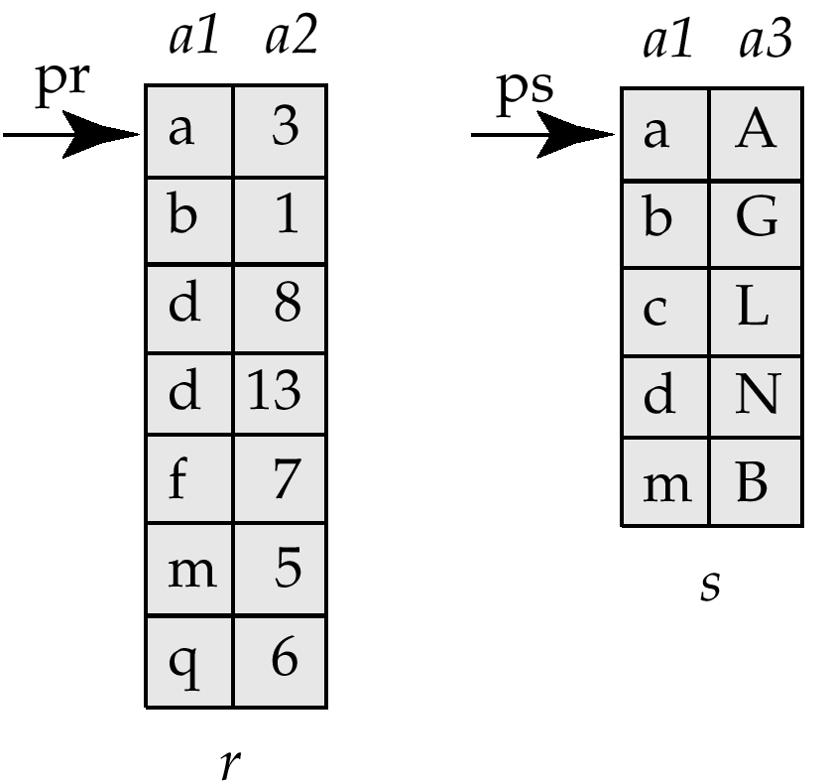
Merge-Join
Sort both relations on their join attribute (if not already sorted on the join attributes)
Merge the sorted relations to join them
  Join step is similar to the merge stage of the sort-merge algorithm
  Main difference is handling of duplicate values in join attribute — every pair with same value on join attribute must be matched
Used only for equi-joins and natural joins
Each block needs to be read only once (assuming all tuples for any given value of the join attributes fit in memory)
Thus number of page accesses for merge-join is b_{r} + b_{s} + the cost of sorting if relations are unsorted (recall external sort-merge)

Slide 30
Hash-Join
Applicable for equi-joins and natural joins
A hash function h is used to partition tuples of both relations into n buckets (i.e., a hash file organization)
h maps JoinAttrs values to {0, 1, ..., n-1}, where JoinAttrs denotes the common attributes of r and s used in the natural join
  r₀, r₁, . . ., r_{n-1} denote partitions of r tuples
    Each tuple t_{r} ∈ r is in partition r_{i} where i = h(t_{r} [JoinAttrs])
  s₀,, s₁. . ., s_{n-1} denote partitions of s tuples
    Each tuple t_{s} ∈s is in partition s_{i}, where i = h(t_{s} [JoinAttrs])

Slide 31
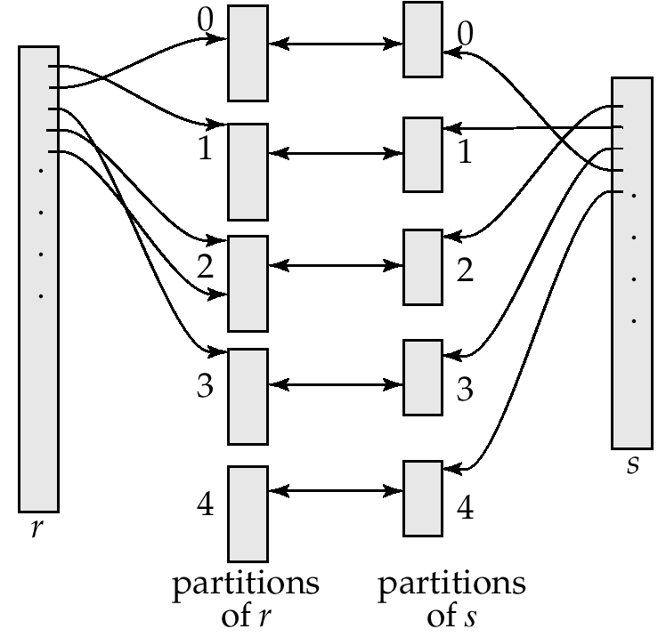
Hash-Join (Cont.)
Benefit: r tuples in bucket/partition r_{i} need only to be compared with s tuples in s_{i}
(I.e. comparison within the same bucket/partition but not others)
Reasons:
  r tuple and s tuple that satisfy the join condition will have the same value for the join attributes
  If that value is hashed to some value i, the r tuple has to be in r_{i} and the s tuple in s_{i}

Slide 32
Hash-Join Algorithm
Partition the relation r using hashing function h. When partitioning a relation, one page of memory is reserved as the output buffer for each partition (Can it be a problem?)
Partition s similarly
For each i:
  Load bucket r_{i} into memory and build an in-memory hash index on it using the join attribute. This hash index uses a different hash function than the earlier one h. Relation r is called the build input
  Read the tuples in bucket s_{i} from the disk page by page. For each tuple t_{s} locate each matching tuple t_{r} in r_{i} using the in-memory hash index Relation s is called the probe input
Cost estimation: Partition: 2(b_{r} + b_{s}) + build and probe: (b_{r} + b_{s}) = 3(b_{r} + b_{s})

Slide 33
Hash-Join algorithm (Cont.)
The number of buckets n is such that each bucket of the build input r should fit in the available main memory pages M. Assuming each bucket has the same size:
  M ≥ ⎡b_{r} / n⎤
Also M ≥ n+1 because for each bucket we should have one buffer page (plus one page for input buffer) for partitioning
In order to satisfy these conditions: M > sqrt(b_{r}) approx
  The probe relation partitions need not fit in memory
Recursive partitioning required if number of partitions n is greater than number of pages M of memory
  Rarely necessary: e.g., With page size of 4KB, recursive partitioning not needed for relations of 1GB or less with memory size of sqrt(1G/4K)x4K, approx 2MB

Slide 34
Example of Hash-Join
Use the relations customer and depositor again
Assume that memory size is M=25 pages b_{depositor}= 100 and b_{customer} = 400
depositor is the build input
  Partition depositor into 5 buckets, each of size 20 pages. This partitioning can be done in one pass.
customer is the probe input
  Partition customer into 5 buckets, each of size 80 pages. This is also done in one pass
Read each bucket in turn of the build input in memory, and probe against records of the corresponding probe bucket
Therefore total cost: 3(100 + 400) = 1500 page transfers
  ignores cost of writing partially filled pages

Slide 35

Further optimization of hash-join: Hybrid hash-join
Useful when memory sized are relatively large and the build input is bigger than memory
Main feature of hybrid hash join:
Keep the first partition of the build relation in memory
E.g. With memory size of 25 blocks, depositor can be partitioned into five partitions, each of size 20 blocks
  Division of memory:
    The first depositor partition occupies 20 blocks of memory
    1 block is used for input, and 1 block each for buffering the other 4 partitions
customer is similarly partitioned into five partitions each of size 80
  The first customer is used right away for probing, instead of being written out
Cost = 3(80 + 320) + 20 +80 = 1300 block transfers for hybrid hash join, instead of 1500 with plain hash-join
Hybrid hash-join most useful if M >>

Slide 36
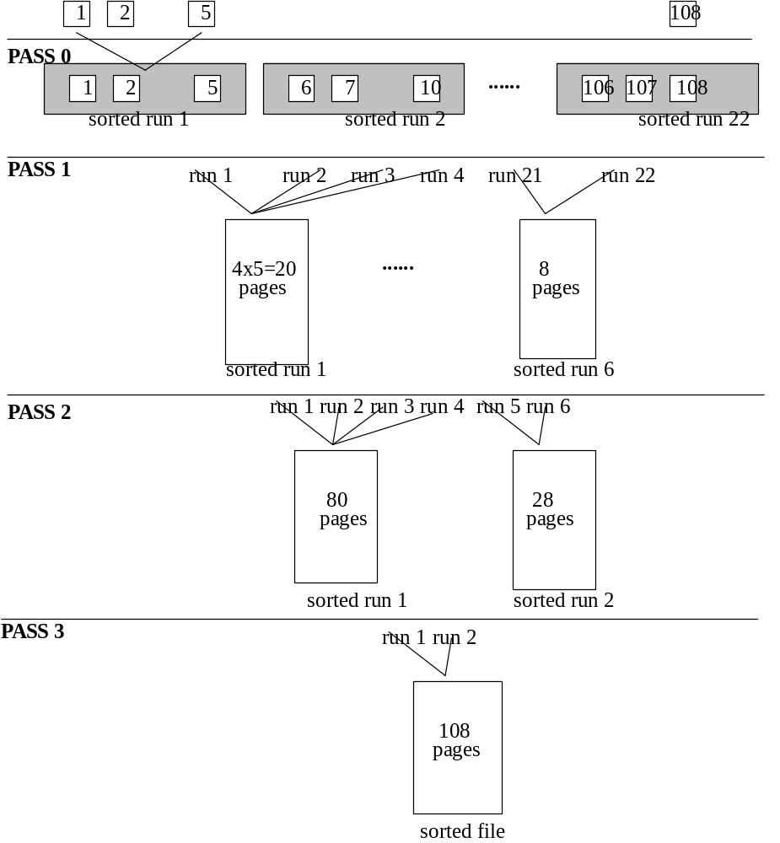
External Sorting Example
What is the cost of sorting a file that has 108 pages, using only 5 pages of main memory.
108x2
108x2
108x2
108

Slide 37
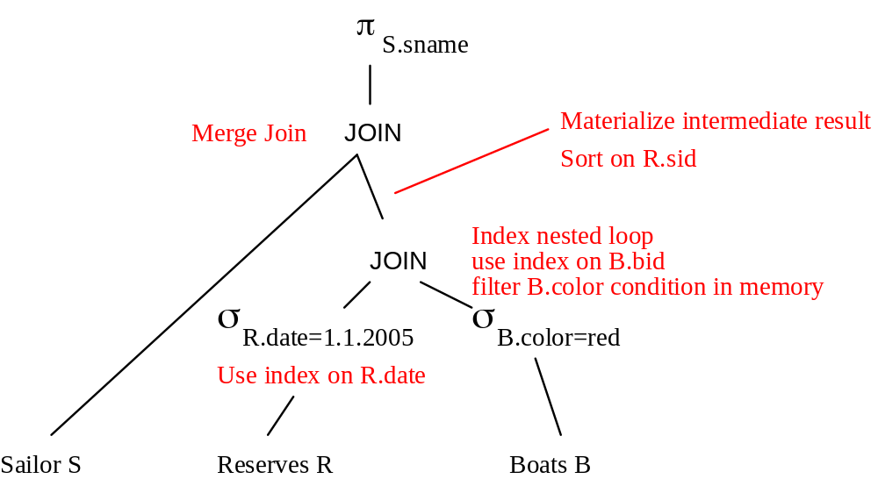
Evaluation Plan
An evaluation plan defines exactly what algorithm is used for each operation, and how the execution of the operations is coordinated
  Materialization: generate results of an expression whose inputs are relations or are already computed, materialize (store) it on disk Repeat
  Pipelining: pass on tuples to parent operations even as an operation is being executed
Example assuming that Sailor is sorted on sid

Slide 38
Dynamic Programming
To find best join tree for a set of n relations:
  To find best plan for a set S of n relations, consider all possible plans of the form: S₁ (S – S₁) where S₁ is any non-empty subset of S
  Recursively compute costs for joining subsets of S to find the cost of each plan. Choose the cheapest of the 2^{n} – 1 alternatives
  When plan for any subset is computed, store it and reuse it when it is required again, instead of recomputing it
  Using DP to select the best join order and grouping!

Slide 39
Join Order Optimization Algorithm
procedure findbestplan(S)
if (bestplan[S].cost ≠ ∞)
return bestplan[S]
// else bestplan[S] has not been computed earlier, compute it now
for each non-empty subset S1 of S such that S1 ≠ S
P1= findbestplan(S1)
P2= findbestplan(S - S1)
A = best algorithm for joining results of P1 and P2
cost = P1.cost + P2.cost + cost of A
if cost < bestplan[S].cost
bestplan[S].cost = cost
bestplan[S].plan = “execute P1.plan; execute P2.plan;
join results of P1 and P2 using A”
return bestplan[S]
Notes:
We construct a table with an entry for each subset of one or more of the n relations. In that table we put:
The estimated size of the join of these relations. (We know the formula for this – V(att, rel))
The least cost of computing the join of these relations.
The expression that yields the least cost.

Slide 40
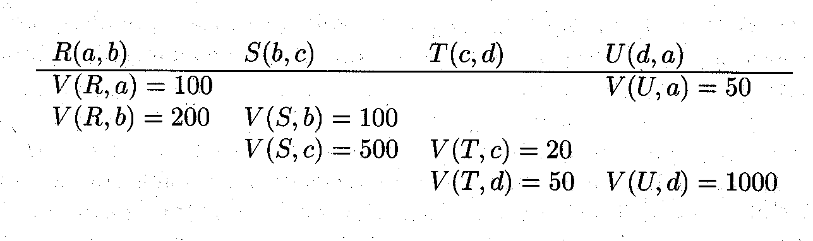
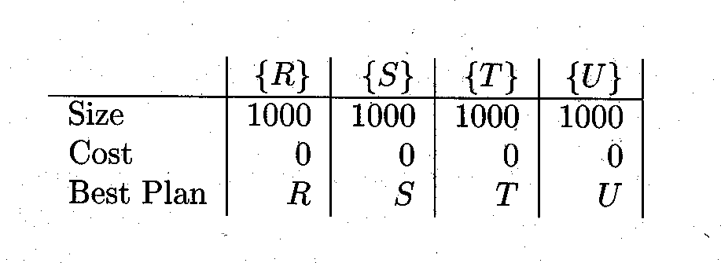


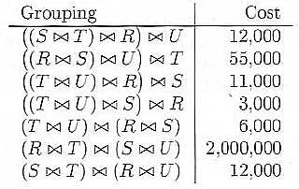
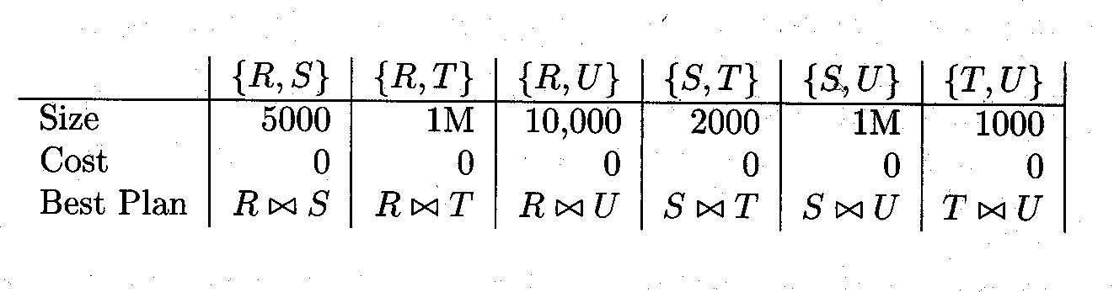
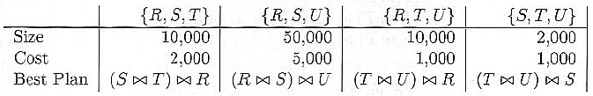
Example of Dynamic Programming
Statistical Data
Table for singleton sets
Join groupings and their costs
Table for pairs
Table for triples
Notes:
The output size of the final join is not counted.

Slide 41
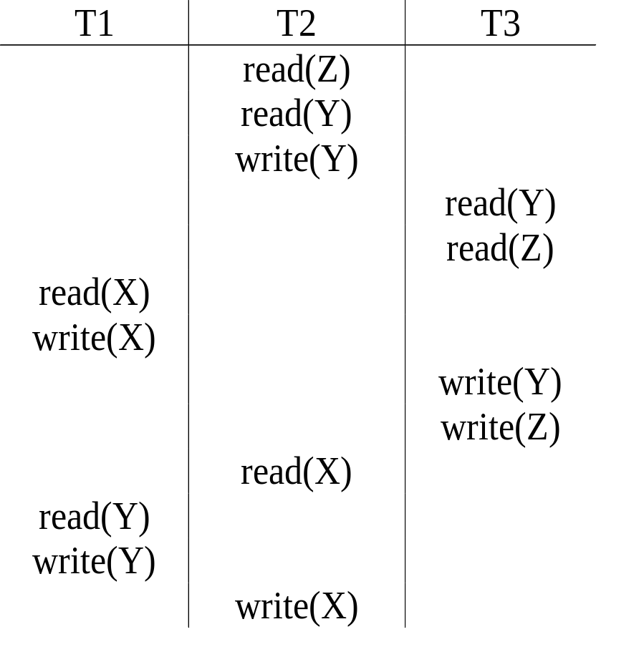
Example Schedule (Schedule A)
Precedence graph
T1
T2
T3
Schedule is NOT serializable
Notes:
2
2

Slide 42
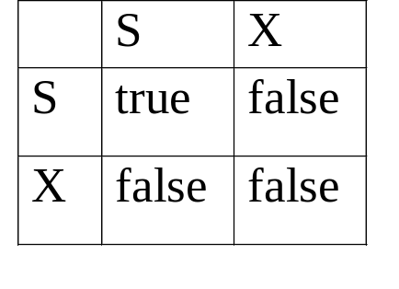
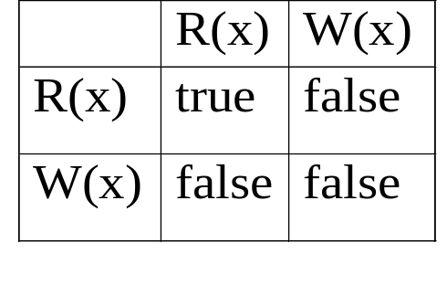
Lock-based Protocols
Locking protocols control concurrent access to data items
The objective is to guarantee serializability of the schedule
Data items can be locked in two modes:
  exclusive (X) mode: no one else can share it; I.e, you can do read or write on the locked item
  shared (S) mode: you can only read the locked item, since others may be reading it at the same time
Lock compatibility:

Slide 43
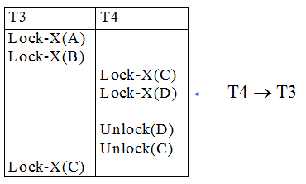
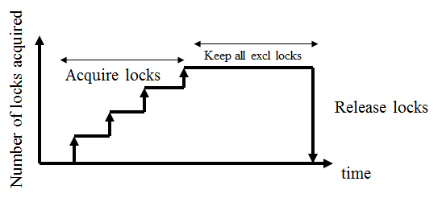
The Two-Phase Locking protocol
Two-phase locking ensures conflict-serializable schedules.
Phase 1: Growing Phase
  transaction may obtain locks but are not allowed to release locks
Phase 2: Shrinking Phase
  transaction may release locks but are not allowed to get new locks
Acquire locks
Release locks
No of locks
acquired
time

Slide 44
Timesstamp- Based Protocols
Each transaction is issued a timestamp when it enters the system. If an older transaction T_{i} has time-stamp TS(T_{i}), a younger transaction T_{j} is assigned time-stamped TS(T_{j}) such that TS(T_{i}) < TS(T_{j}).
The protocol manages concurrent execution such that the time-stamps determine the serializability order.
For each data item Q, two timestamps are maintained:
  W-timestamp(Q) is the largest time-stamp of any transaction that executed write(Q) successfully.
  R- timestamp(Q) is the largest time-stamp of any transaction that executed read(Q) successfully.
Data
items
TS(T1)
W-TS(Q), R-TR(Q)
T1
W-TS(R), R-TR(R)
TS(T2)
T2
W-TS(S), R-TR(S)

Slide 45
Example Use of the Protocol
A partial schedule for transactions with timestamp 1, 2, 3, 4, 5
T1
T2
T3
T4
T5
Read(X)
Read(Y)
√
√
Read(Y)
√
Write(Y)
√
Write(Z)
x
Read(Z)
Read(Z)
√
√
abort
x
Read(X)
√
Write(Z)
abort
Write(X)
Write(Z)
Aborted transactions are restarted with new timestamps

Slide 46
More Practices

Slide 47
External Sorting
Consider a file Sailor (SID, name, rating, age), which is not sorted. Assume that each attribute is 25 bytes, the page size is 1000 bytes and that there are 11,000 records. For the following questions, apply external sorting using a buffer of 11 pages.
How many sorted runs will you produce in pass 0?
(A) 10
(B) 11
(C) 100
(D) 110
(E) None of the above.
Record size 100 bytes. Blocking factor 10 records per page. File size 1100 pages. At pass zero I sort in memory 11 pages at the time. Therefore, at pass zero I produce 1100/11= 100 sorted runs

Slide 48
External Sorting
What is the total number of passes required to sort the result completely (including pass 0)?
(A) 1
(B) 2
(C) 3
(D) 4
(E) 5
After pass zero I have 100 sorted runs. At pass 1, I merge 10 passes at the time, producing 10 sorted runs. At pass 2, I merge these 10 sorted runs to produce the final output. Total number of passes is 3.

Slide 49
External Sorting
What is the total I/O cost of sorting?
(A) 4,400
(B) 5,500
(C) 6,600
(D) 7,770
(E) None of the above.
I have a total of three passes. At each pass I read and write the whole file (1100 pages), i.e., a total cost of 3x2x1100=6600. However, I have to remove the cost of writing the final output; i.e., the final cost is 6600-1100=5500

Slide 50
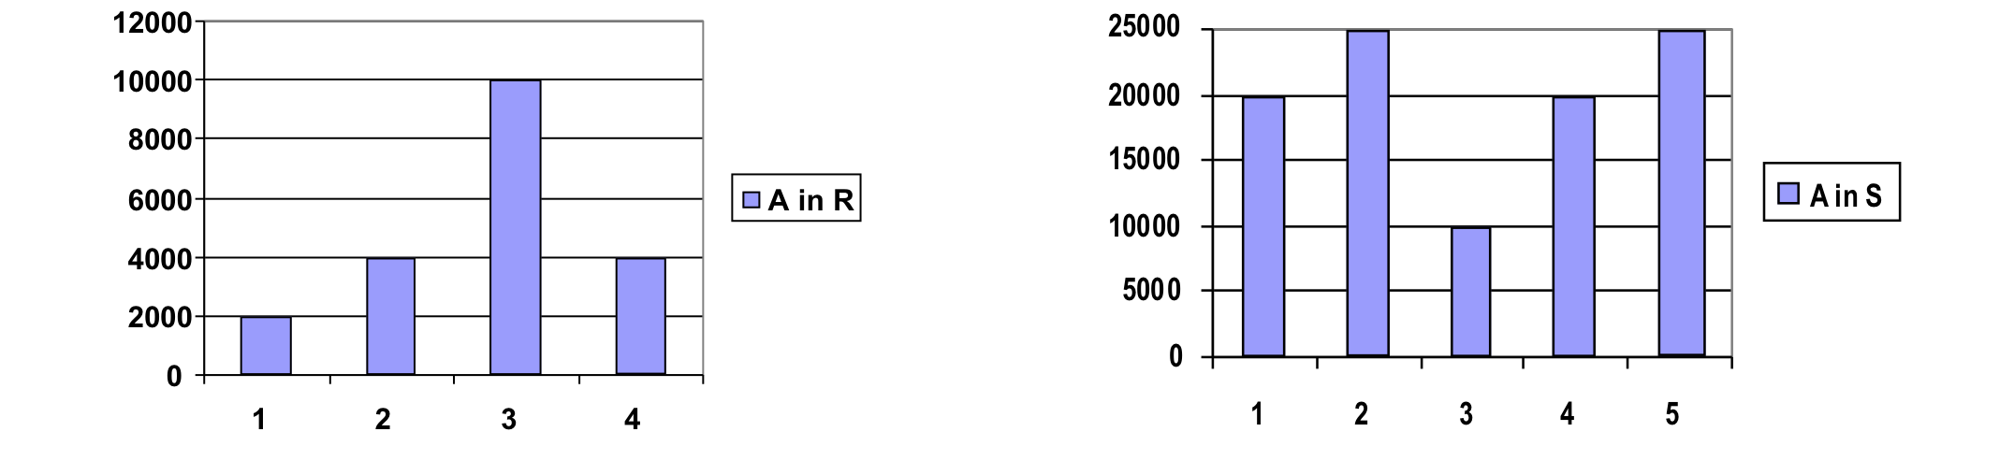
Selectivity Estimation and Join Processing
You are given two tables: R(A, B, C) and S(A, B, Y).
R contains 20,000 records, and S contains 100,000 records.
Assume that you can fit 10 records per page for both files, i.e., the size of R is 2,000 pages and that of S is 10,000 pages.
The possible values of attribute A in R are: {1,2,3,4}, whereas the possible values of A in S are {1,2,3,4,5}. The following histograms present statistical information about the occurrences of values for A in R and S, e.g., there are 2,000 records with A=1 in R and 20,000 records with A=1 in S.

Slide 51
Selectivity Estimation and Join Processing
How many records (i.e., cardinality of the output size) are there in the result of the query (R JOIN_{R.A=S.A} S)?.
(A) 20,000
(B) 100,000
(C) 120,000
(D) 320,000
(E) 320,000,000
According to the histograms, each (of the 2,000) record of R with value R.A=1, can join with 20,000 records with S.A=1 of S. That is, the join result will contain 2,000x20,000=40x10⁶ results where R.A=S.A=1
Performing the same computations for A=2, 3, 4, 5, I obtain that the final result will contain: (40+100+100+80+0) x10⁶=320,000,000 records.

Slide 52
Selectivity Estimation and Join Processing
What is the minimum cost (in terms of I/O operations) for computing (R JOIN_{R.A=S.A} S) using block nested loops and how many main memory pages do you need (the size of R is 2,000 pages and that of S is 10,000 pages)?
(A) Minimum cost is 12,000 and I need 2,000 main memory pages
(B) Minimum cost is 12,000 and I need 2,002 main memory pages
(C) Minimum cost is 12,000 and I need 12,000 main memory pages
(D) Minimum cost is 320,000 and I need 2,002 main memory pages
(E) Minimum cost is 320,000 and I need 12,000 main memory pages
Since there is no index, we have at least to read both files, i.e., minimum cost is 12,000 pages, independently of the algorithm. For block nested loops, I need to be able to read the smaller file R (2,000 pages) in memory, so that I scan S only once. In addition, I need 1 page for reading S and 1 page for output, i.e., a total of 2,002 pages.

Slide 53
Selectivity Estimation and Join Processing
We want to compute (R JOIN_{R.A=S.A} S) using block nested loops and R as the outer relation. What is the minimum number of main memory pages that you need in order to achieve cost 42,000 page accesses (the size of R is 2,000 pages and that of S is 10,000 pages)?
(A) 502
(B) 736
(C) 1,000
(D) 1,002
(E) 2,000
Since R is the outer table, and total cost is 42,000 page accesses, we need to scan S, 4 times. This means, that we have 4 blocks for R, and each block should be at least 2,000/4=500 pages. Since, we also need a page for reading S and 1 for output, in total we need 502 memory pages.

Slide 54
Selectivity Estimation and Join Processing
We want to compute (R JOIN_{R.A=S.A} S) using hash join and R as the build input. How many buckets we should use for partitioning, and what is the minimum main memory requirement (the size of R is 2,000 pages and that of S is 10,000 pages)?
(A) I will use 4 buckets, in which case I need at least 202 main memory pages.
(B) I will use 4 buckets, in which case I need at least 1,002 main memory pages.
(C) I will use 10 buckets, in which case I need at least 202 main memory pages.
(D) I will use 10 buckets, in which case I need at least 502 main memory pages.
(E) I will use 20 buckets, in which case I need at least 102 main memory pages.
Note that the join condition is R.A=S.A and there are only four values of A in R. Therefore, we should use 4 buckets. According to the histograms, half of records of the build input A, have value R.A= 3. Thus, the bucket size should be 1,000 pages. In addition, we need 1 page for reading S and 1 for the output. Thus, we need 1,002 main memory pages.

Slide 55
Selectivity Estimation and Join Processing
Given that R.B is a NOT NULL foreign key referencing S.B, how many records are in the result of the query (R JOIN_{R.B=S.B} S)
(R(A, B, C), S(A, B, Y), R contains 20,000 records, and S contains 100,000 records)
(A) 20,000
(B) 100,000
(C) 120,000
(D) 320,000
(E) 320,000,000
Each record of R joins with exactly one record in S. Thus the size of the join result is the same as R: 20,000.

Slide 56
Selectivity Estimation and Join Processing
We want to compute (R JOIN_{R.B=S.B} S) using index nested loops and R as the outer relation. We assume that there is a hash index on S.B with no overflow buckets (i.e., finding an index entry has cost 1). What is the total cost?
(A) 6,000
(B) 22,000
(C) 40,000
(D) 42,000
(E) None of the above.
For each record of R, we find the index entry with the corresponding value of B and follow the pointer to the record of S, i.e., cost of 2 page accesses per record. We repeat this process for all 20,000 records of R, for a total cost of 40,000. In addition, I have to read the records of R, i.e., the final cost is 40,000+2,000=42,000

Slide 57
Selectivity Estimation and Join Processing
How many records are there in the result of ((σ_{A=1}R) JOIN_{R.B=S.B} S) and what is the minimum cost of processing the query using index nested loops and R as the outer relation. We assume that the only index is a hash index on S.B with no overflow buckets.
(A) There are 2,000 records and the cost is 6,000
(B) There are 2,000 records and the cost is 22,000
(C) There are 20,000 records and the cost is 40,000
(D) There are 20,000 records and the cost is 42,000
(E) None of the above.
According to the histograms, there are only 2,000 records in R with R.A=1. Each of these records, matches (R.B=S.B) exactly 1 record in S. Thus the result contains 2,000 records. Finding the matching record in S, has cost 2 (see previous question), i.e., finding all matches for the 2,000 records has cost 4,000. After adding the cost of reading R, the total cost is 6,000

Slide 58
Selectivity Estimation and Join Processing
How many records are expected in the result of ((σ_{A=1}R) JOIN_{R.B=S.B} (σ_{A=3}S)) and what is the minimum cost of processing the query using index nested loops and R as the outer relation. We assume that the only index is a hash index on S.B.
(A) The expected number of records in the result is 200, and the cost is 600
(B) The expected number of records in the result is 200, and the cost is 6,000
(C) The expected number of records in the result is 2,000, and the cost is 6,000
(D) The expected number of records in the result is 2,000, and the cost is 42,000
(E) None of the above.
Query processing is the same as in the previous question with cost 6,000. However, according to the histogram of S, among the 2,000 records in the result of ((σ_{A=1}R) JOIN_{R.B=S.B} S), only 10% are expected to satisfy the condition S.A=3. Thus, the result is expected to contain 200 records.

Slide 59
Transaction Management
Consider the following schedules of two transactions T1 and T2. Indicate each is serial, (conflict) serializable, or not serializable. R denotes a READ, and W is a WRITE operation.
R1(A) W1(A) R2(A) W2(B)
Serial: T1, T2
R1(A) R2(A) W1(A) W2(B)
Serializable: T2, T1
R1(A) R2(A) W2(A) W1(A)
Not Serializable

Slide 60
Transaction Management
Q1: Is the schedule R1(A) W1(A) R2(A) W2(B) C1 C2 recoverable and cascadeless? (C1 and C2 indicate the commit statements).
It is recoverable but not cascadeless.
Q2: Change the time of commits (C1, C2) in the schedule in Q1 so that it becomes a cascadeless schedule.
R1(A) W1(A) C1 R2(A) W2(B) C2; i.e., transaction T2 reads the value of A written by T1, after T1 commits.
Q3: Is the schedule R2(A) R1(A) W1(A) W2(B) C2 C1 recoverable and cascadeless?.
Both recoverable and cascadeles - no transaction reads items written by the other.

Slide 61
Transaction Management
Rewrite the schedule R2(A) R1(A) W1(A) W2(B) according to 2PL protocol (i.e., add lock-S, lock-X, unlock statements below). Explain briefly whether the schedule is allowed by 2PL.
T1 | T2
 | lock_S(A) READ(A)
lock_S(A) READ(A)
lock_X(A) - cannot WRITE(A)
 | WRITE(B)

Slide 62
Transaction Management
Rewrite the schedule R2(A) R1(A) W1(A) W2(B) according to TS-ordering protocol (i.e., add read_TS and write_TS statements) assuming that the timestamps of T1, T2 are 2, 1, respectively. The initial read and write timestamps of A and B are all 0.
T1, timestamp=2 | T2, timestamp=1
 | READ(A) read_TS(A)=1
READ(A) read_TS(A)=2
WRITE(A) write_TS(A)=2
 | WRITE(B) write_TS(B)=1

Slide 63
Transaction Management
Rewrite the schedule R2(A) R1(A) W1(A) W2(B) according to multi-version TS-ordering protocol (i.e., add read_TS and write_TS statements and specify the versions of the items) assuming that the timestamps of T1, T2 are 1, 2, respectively and that the initial versions of items are A0, B0. Complete the correct version numbers (e.g., READ(A0) instead of READ(A)).
T1, timestamp=1 | T2, timestamp=2
 | READ(A0) read_TS(A0)=2
READ(A0) read_TS(A0)=2
WRITE(A1) Failure because read_TS(A0)=2
 | WRITE(B)

